Slide 1
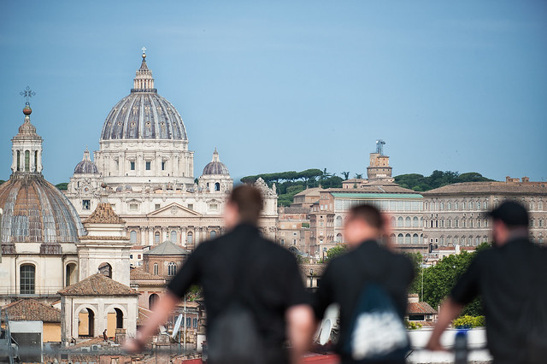
Young people values, hopes and expectations
Faith and religion
Global results report
Madrid, 2023
GAD3.COM ● C/ Alcalá, 75- 4º Izq. 28009 Madrid T.: +34 91 369 79 94
© 2023 GAD3

Slide 2
Technical sheet
Universe: young people between 18 and 29 years old.
Scope: Argentina, Brazil, Italy, Kenya, Mexico, Philippines, Spain and UK.
Quotas: by sex, age and geography according to the distribution of the population in each country.
Data collection procedure: computer-assisted online interview (CAWI).
Sample size: 4.889 total interviews distributed by country as shown in the table on the right.
Sampling error: ±1,4% (n=4.889), for a degree of confidence of 95.5% (two sigmas) and under the worst-case scenario of P=Q=0.5 under the assumption of simple random sampling.
Interview duration: 9-10 minutes approximately, 37 questions.
Fieldwork dates: from November 16th to December 11th 2023.
Country | Sample
Argentina | 604
Brazil | 600
Italy | 605
Kenya | 670
Mexico | 606
Philippines | 600
Spain | 601
UK | 603
Total | 4.889

Slide 3
Interviewee profile (I)
Indicate your gender
Average age
23,8
Indicate your age
Indicate your country of residence.
N: 4.889

Slide 4
Interviewee profile (II)
Indicate your level of education
Indicate your current employment situation
Indicate who do you currently live with
Indicate your current marital status
N: 4.889

Slide 5
2
Values Perception

Slide 6
Spirituality presence
To what extent do you consider that spirituality has been present in your life?
Very present + Fairly present
By belief
Very present + Fairly present
73%
By country
N:4.889

Slide 7
Spirituality evolution
Compared to 5 years ago, now you believe that spirituality is...
By belief
By country
N: 4.889

Slide 8
Religious statements
To what extent do you agree with the following religious statements?
Strongly agree + Fairly agree
70%
67%
67%
60%
59%
57%
54%
49%
45%
43%
N: 4.889

Slide 9
Religious statements by belief
To what extent do you agree with the following religious statements?
The five statements with the highest percentage of agreement
Strongly agree + Fairly agree
N: 4.889

Slide 10
Social/Moral statements
To what extent do you agree with the following social statements?
Strongly agree + Agree
91%
90%
73%
70%
66%
40%
N: 4.889

Slide 11
Social statements by belief
To what extent do you agree with the following social statements?
Strongly agree + Agree
N: 4.889

Slide 12
Social opinions
Do you….?
N:4.889

Slide 13
Social opinions by belief
Do you….?
% Yes
N: 4.889

Slide 14
3
Beliefs and/or faith

Slide 15
Beliefs
Most young people claim to believe in God.
Regarding your beliefs, from the following options, indicate which ones you most identify with:
N: 4.889

Slide 16
Beliefs by country
The countries with the highest percentage of young believers coincide with the countries where the presence of spirituality is stronger, which are Kenya, the Philippines and Brazil. In Italy and Spain there are more atheists and/or agnostics than believers.
Believer
Atheist/Agnostic
DK/NA
Argentina | Brazil | Italy | Kenya | México | Philippines | Spain | UK
Regarding your beliefs, from the following options, indicate which ones you most identify with:
N: 4.889

Slide 17
Faith traditions by country
Catholicism is present among young people especially in the Philippines and Italy. In the case of Italy, there are many young people who, even if they define themselves as atheists, feel identified with the Catholic religion.
Catholic
Other religions
None
Argentina | Brazil | Italy | Kenya | México | Philippines | Spain | UK
Which of the following faith traditions below do you most identify with?
N: 4.889

Slide 18
5
God believers

Slide 19
Praying frequency
How often do you pray?
By faith tradition
By country
N: 3.141

Slide 20
Mass/Services attendance frequency
How often do you attend religious services/mass?
By faith tradition
By country
N: 3.141

Slide 21
Praying habits by faith tradition
To whom do you turn in prayer? Multi-response
The five most mentioned
N: 3.141

Slide 22
Methods of praying by faith tradition
How do you pray on your own? Multi-response
The five most mentioned
N:3.141

Slide 23
Church Perception by faith tradition
What is the Church, predominantly for you?
% Yes
N:3.141

Slide 24
6
Catholic believers

Slide 25
Belief statements
To what extent do you agree with the following belief statements?
Strongly agree + Fairly agree
73%
72%
35%
N: 1.898

Slide 26
Bible perception
Regarding the reading of the Bible, choose the statement you most agree with from the following choices:
By country
N: 1.898

Slide 27
Catholic doctrine opinion
Regarding Catholic doctrine, indicate whether you agree with the following statements.
N: 1.898

Slide 28
Catholic doctrine opinion
Jesus is truly present in the Holy Eucharist
The sacrament of Confirmation comes with great responsibility
Baptism makes us children of God
YES
NO
DK/NA
N: 1.898

Slide 29
Catholic statements
How much do you agree or identify with the following statements?
Strongly agree + Agree
81%
72%
69%
55%
47%
N: 1.898

Slide 30
Reason to stop attending Mass
Why did you decide not to go to Mass anymore? Multi-response
Only respondents who answered “I used to go to religious services/mass, but I don’t anymore”
N:151

Slide 31
Opinion about Confession
Regarding Confession, choose the statement that identifies you best.
By country
N: 1.898

Slide 32
Reason to stop going to Confession
Why did you decide not to go to Confession anymore? Multi-response
Only respondents who answered “I used to go to Confession, but I don’t anymore”
N:163

Slide 33
Marriage sacrament
Are you sacramentally married?
By country
N: 1.898

Slide 34
Marriage sacrament planning
Do you plan to get married in the Church?
Only respondents who are not sacramentally married
By country
N: 1.488

Slide 35
Consulting · Research · Comunication
www.gad3.com
T.: +34 91 369 7994
info@gad3.com
CRA 13 No. 77 17 PISO 2
Bogotá D.C ,Colombia
C/Alcalá 75,4 º izq.28009 –
Madrid, España

